Slide 1
Light Field Imaging Toolbox

Slide 2
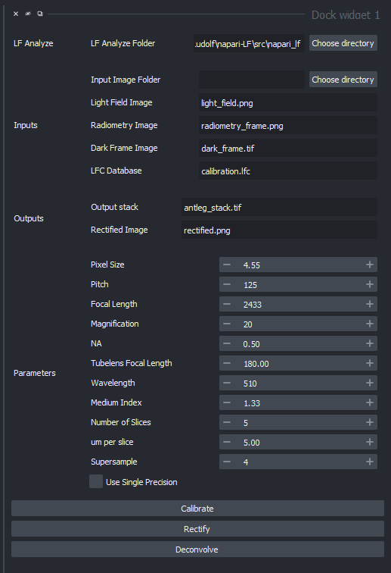


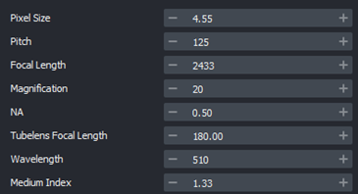
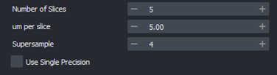


Slide 3
Design goals
Modular
Extensible
Interfaces and implementations
APIs/SPIs... accessible from notebooks or napari
Interoperable
Light Field Imaging (napari plugin)
adapters to ImageJ, ImgLib2, Bioformats,

Slide 4
Modules
design interfaces for the entire workflow, regardless of implemention
LFAcquire (using umgr?, later)
LFMeta, LFData
LFData.import, transform
LFCalibrate
LFRectify
LFDeconvolution
LFDeepLearn, LFInference
LFView… LFDisplay

Slide 5
Jupyter
LFI Plugin
LFMeta, LFData
LFData.import, transform
LFCalibrate
LFRectify
LFDeconvolution
LFI Gui
LFI Gui

Slide 6
Data and Metadata
File / dataset naming
Containers / file formats
Metadata
LFMeta specify metadata req'd
LFData + utilizes LFMeta
napari metadata?

Slide 7
Files
<Sample folder>
Sample.lfm
…
….
RawLFImage.tif
stack
deconvolve
LF metadata, text
JSON
rectify
DarkImage.tif
Perspective
(subaperture)
calibrate
Calibration file
WhiteImage.tif

Slide 8
Data Objects
Select Dataset
(folder or .h5)
Select Output
[as file, as dataset on .h5]
<folder or .H5>
Input/adjust Metadata
Defaults/file
<SampleSet>
metadata.lfm
(.json)
Calibration file
.lfc
Select White & Dark
Calibrate
WhiteImage
Rectified
Inspect Calibration
DarkImage
Perspective
(subaperture)
Select RawLF(s)
View Rectified
View Perspectives
Select Quick Deconvolve method/params
<SampleSet>
Quick Deconvolve
Perspective
RawLFImage
Select Full Deconvolve method/params
Full Deconvolve
Quick Stack
Stack
3D View of Stack

Slide 9
<folder or .H5>
Instrument/Acq
WhiteImage
metadata.lfm
(.json)
DarkImage
<SampleSet>
Perspective
(subaperture)
RawLFImage
Calibration file
.lfc
Quick Stack
Perspective
(subaperture)
Stack
Rectified
<SampleSet>
Perspective
(subaperture)
RawLFImage
Quick Stack
Stack

Slide 10
Instrument
Data
Deconvolve
Other
Number of slices
um per slice
Supersample
Use Single Precision
Algoithm
Action
Action
Action
Action
Action
Action
Action
Action

Slide 12
Select Dataset location
(folder or .h5)
Select RawLF(s)
Set Metadata
NA, mag, pitch, …
View RawLF(s)
View Rectified
Quick Deconvolve
Select White & Dark
View Perspectives
Full Deconvolve
Calibrate
Select Output
[as file, as dataset on .h5]
Settings:
Device
3D View of Stack
Inspect Calibration
Set Quick Deconvolve method/params
Set Full Deconvolve method/params

Slide 13
Files
May be files in a folder or datasets contained in HDF5 file.
Naming
Unique <sample> name
LF metadata file .lfm (text, JSON)
Tool to generate LFmeta
App to fill in values
acquisition system might create

Slide 14
LFI Plugin Design
HDF5 file structure and metadata
Start with LFMNet's HDF5 dataset file
GUI functions/details
Save the last state of the plugin, so that on the next startup the last dataset path is loaded along with the last parameters used. I'm sure napari should have some api for this already. See Persistence: https://napari.org/guides/preferences.html
Option to use the LF-Analyze folder option, to select one that is not included with the plugin. Currently that folder option has been disabled since I couldn't figure out a way to load the LF Analyze library from within the plugin.
Better progress indicator, however, this would need tweaking the LFA code to emit events.
https://napari.org/guides/event_loop.html
Add tooltips to existing GUI items
Annoyingly, to have a cascading menubar for the plugin it seems to need more than 1 widget, so have left the Example QWidget there as well for now. (defined in napari.yaml)
Good docs here: https://napari.org/guides/magicgui.html
Plugin layout design (separate widgets and/or tabs etc.) and User feedback regarding workflow
Articulate Use Cases/Workflow ... review with Rudolf
including:
Additional options that are included in script to be included in an additional tab as "Optional parameters".
Install / Config / Dependencies
Some message prompt to indicate about required libraries that are missing like opencv, h5py, etc. (these need to be installed into your napari env since they don't seem to install with napari)

Slide 15
GUI
Leveraging napari infrastructure…
GUI
MagicGUI
QtPy (abstraction layer over PyQT, PySide)
Leverage VizPy, Scikit-image, …
(Later…) Acquisition, camera control, drivers → Micromanager?

Slide 16
Input from LFAnalyse….

Slide 17
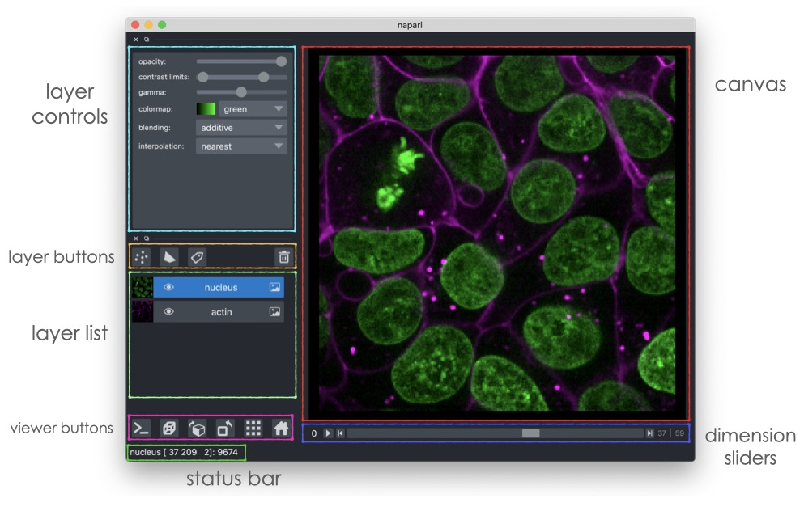
UI

Slide 18
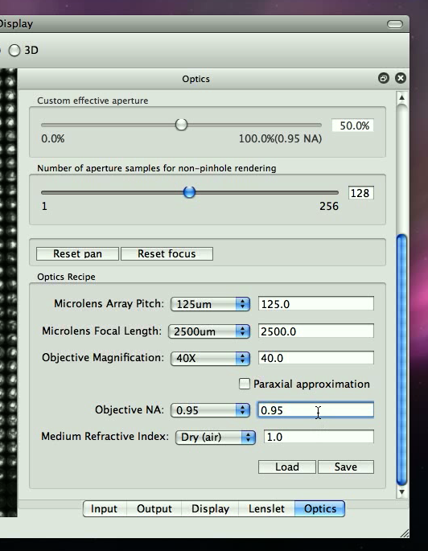
Optics [Config]

Slide 19
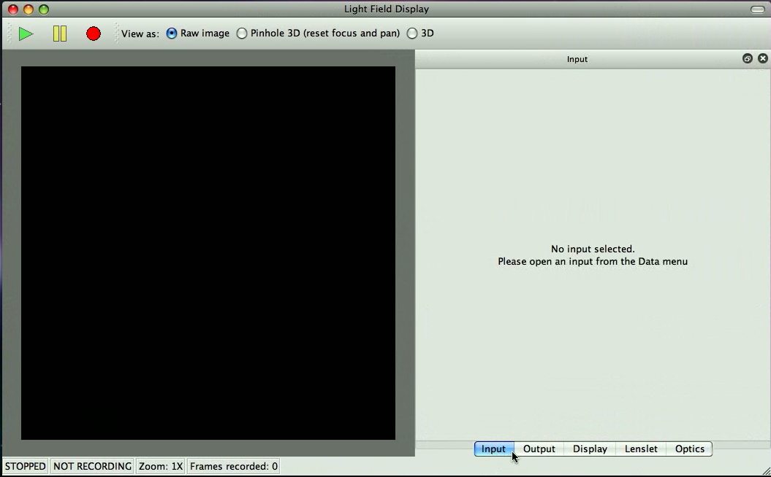

LFDisplay – Main window

Slide 20
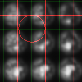
Lenslet

Slide 21
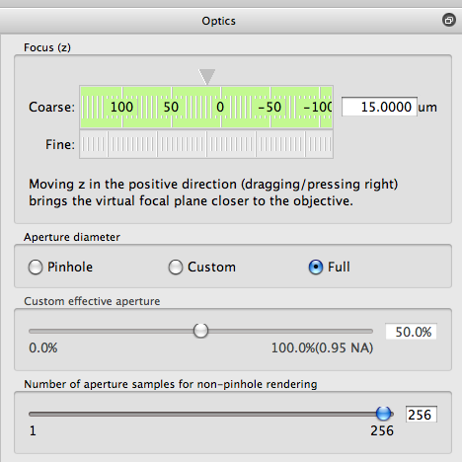
Optics [Explore]

Slide 22
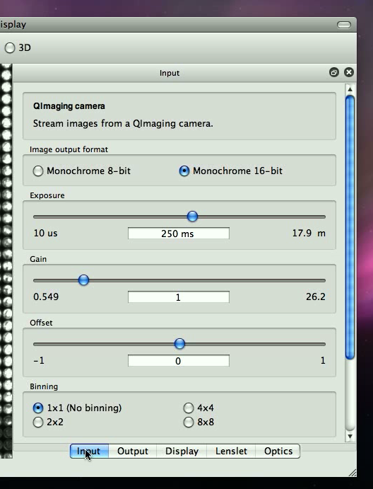
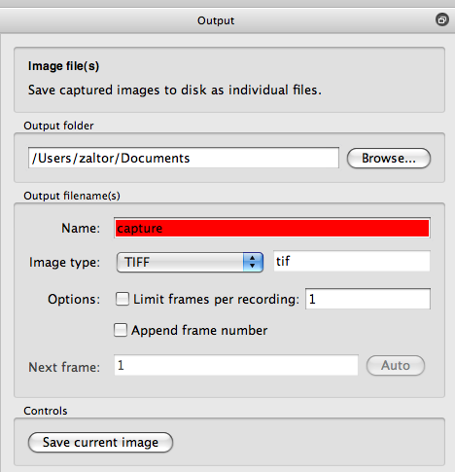
Input, Output
Camera control
Acquisition
File save

Slide 23
ImgNav…
Py version of ImgNav... in python?
add subdir organization and metadata/description/notes in file descibeme.
preview image. preview.tif [gif, jpg, png] with tiff [single|multiple page]]?
specify representative thumbnail
like a readme.

